Slide 1
Finite Differences:
Staggered Grids
Alex Matheson and Austin Nhung
Presentation 3
April 3, 2018

Slide 2
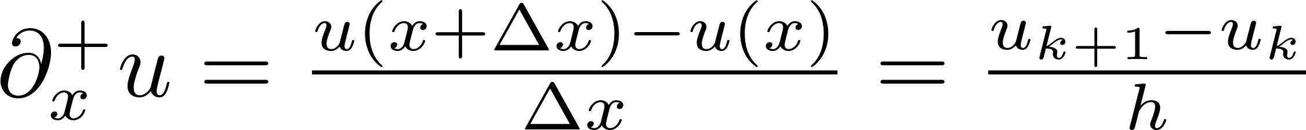
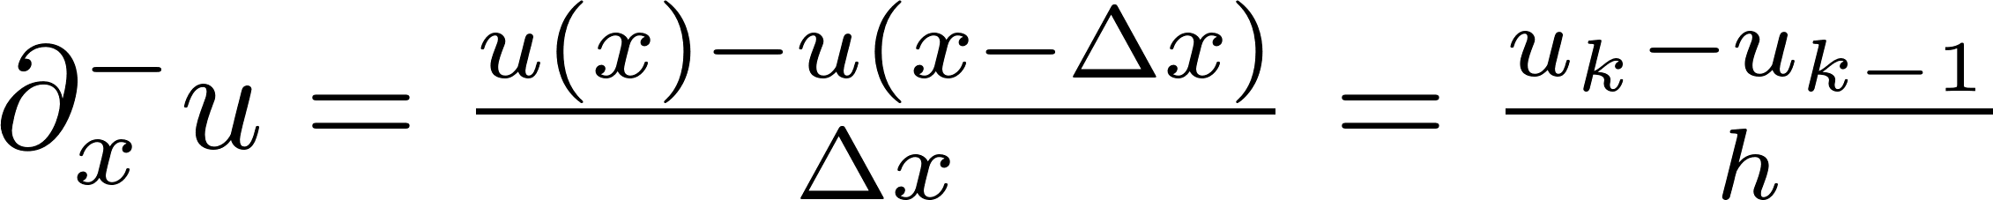
Review: Finite Differences
Finite differences is a way to evaluate differential equations in a discrete manner.
There are a few different ways that finite differences may be performed:
Forward
Reverse
Centered

Slide 3
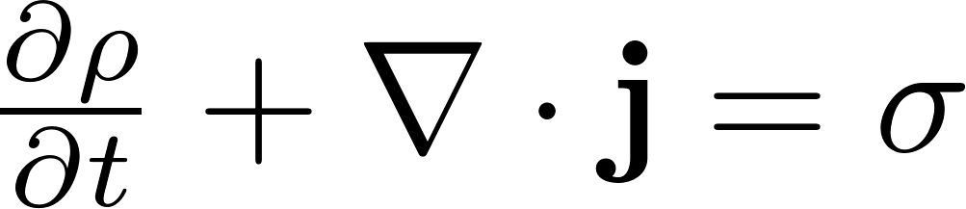
1st Order DEs
So far we have mainly dealt with DEs that are 2nd order in space.
1st order DEs have some peculiarities in terms of time effects
Ex: The Continuity Equation
ρ – quantity density j – flux σ - generation

Slide 4
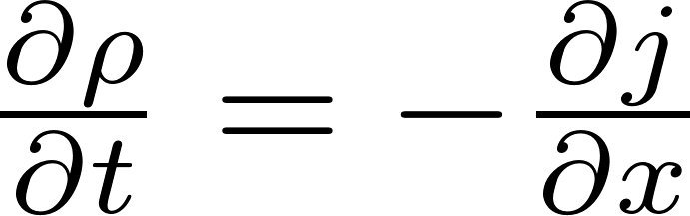
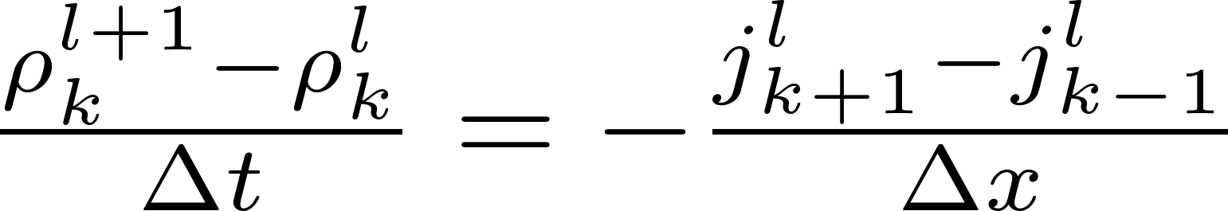
Continuity FDs
We want to minimize error, so we will use the central difference method in space, and the forward difference in time. We will consider the case where σ=0.

Slide 5
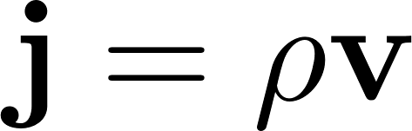
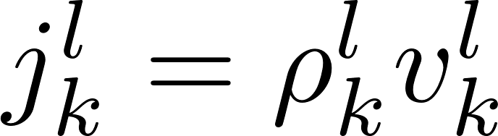

Associated Equations
In simulations of electrical charge, fluid dynamics, etc. The variables are closely related.

Slide 6
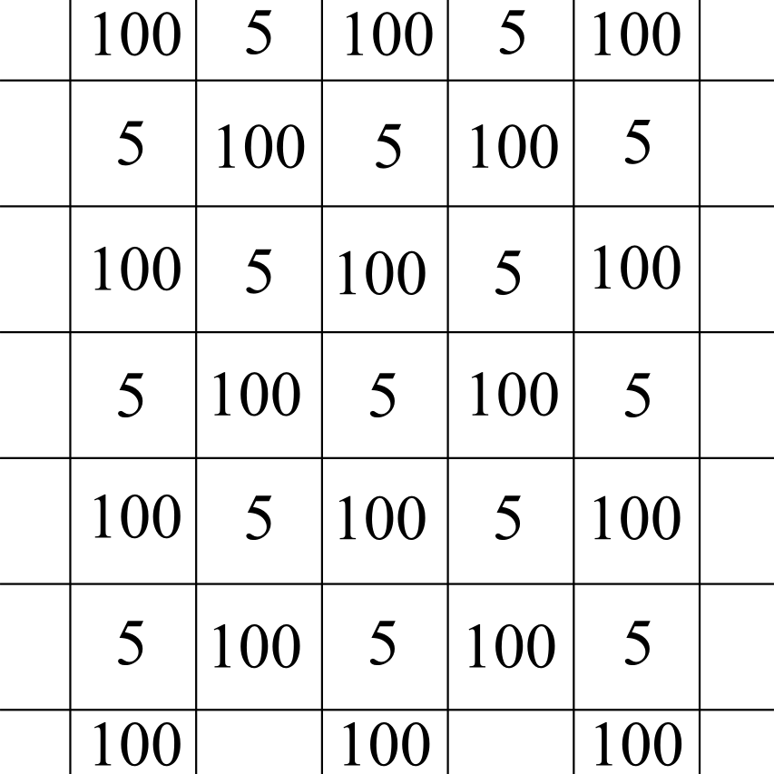
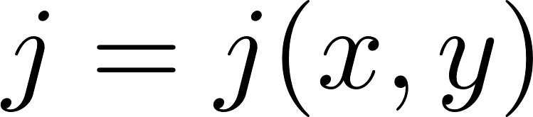
The Checkerboard Problem
Consider some theoretical system where the flux is constant in time:
Next, assume that when discretized, it oscillates between different values:

Slide 7
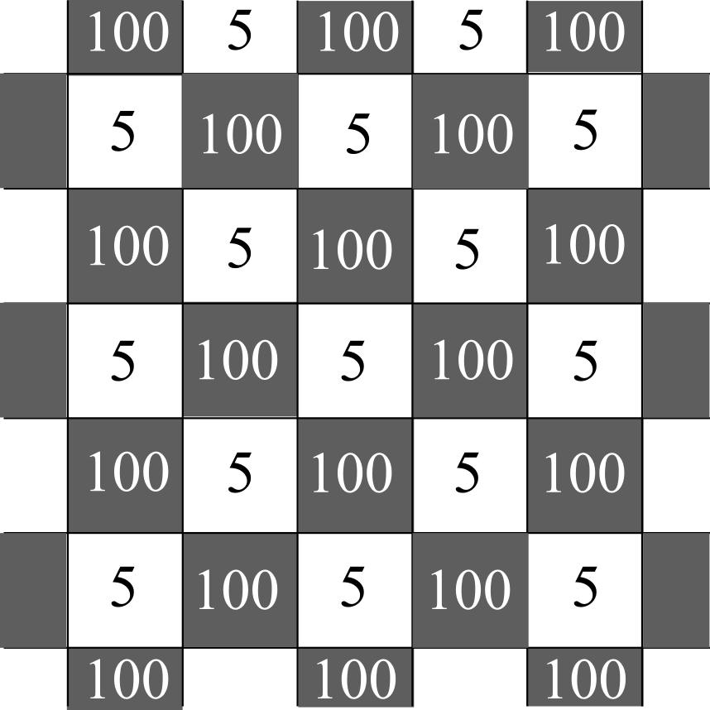
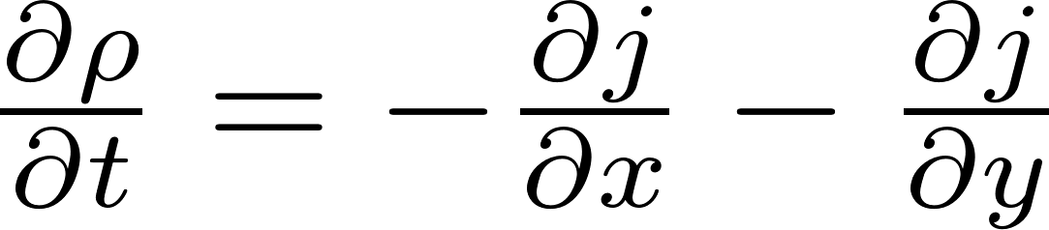
The Checkerboard Problem
This produces the most simplistic checkerboard pattern.
Analytically, we expect the density to behave as such:

Slide 8
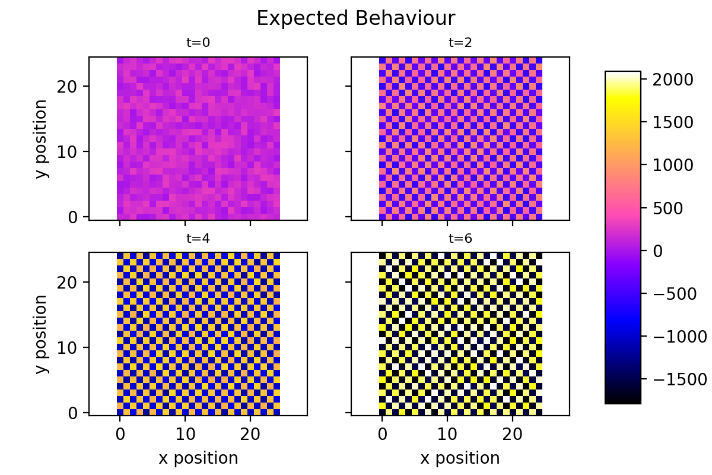
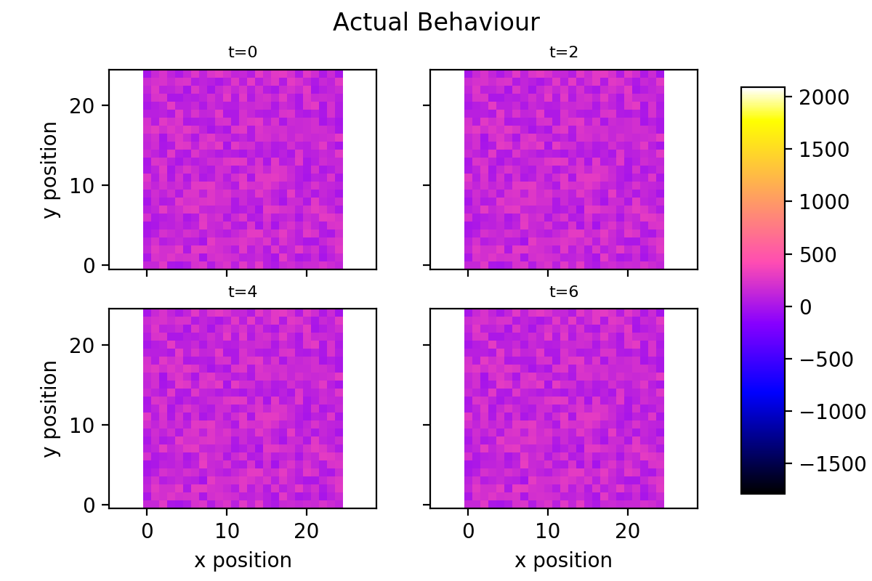
Testing Checkerboard
When we run our finite difference algorithm, the result isn’t what we expect.
It turns out our co-local coordinates respond poorly to high-frequency information and produce inaccurate results when exposed to high-frequencies

Slide 9
Possible solutions
Increase the grid resolution
This is computationally inefficient
Use only forward or reverse finite differences, not the centered difference
This will increase error in our results and defeats the purpose
Use staggered grids
The accepted solution

Slide 10
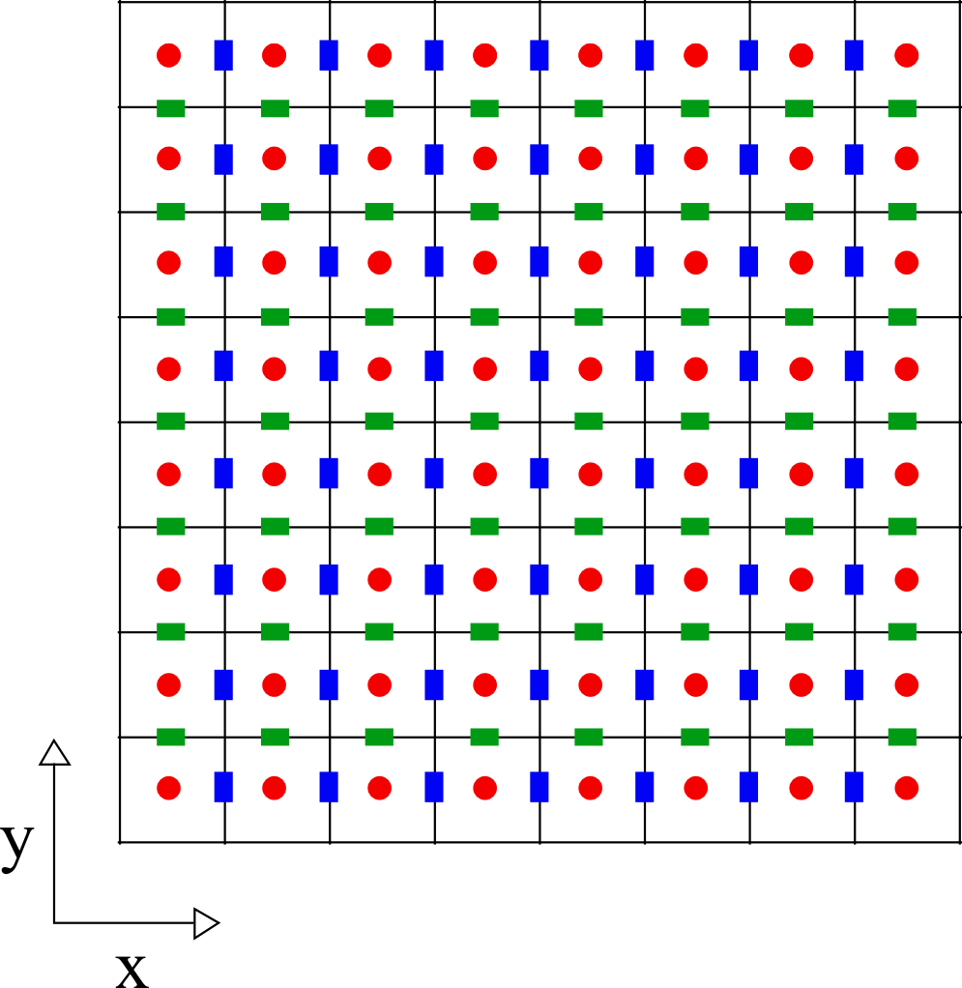
Staggered Grids
When we have differential equations that rely on 1st derivatives, use 2 grids: one for the scalar quantity, and another for the vector, shifted a half-step from the scalar grid.
We can add further shifted grids for each additional first derivative

Slide 11
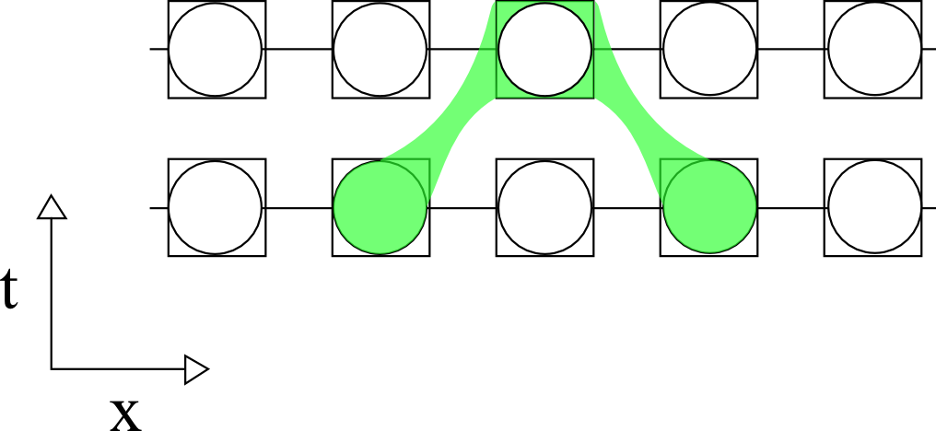
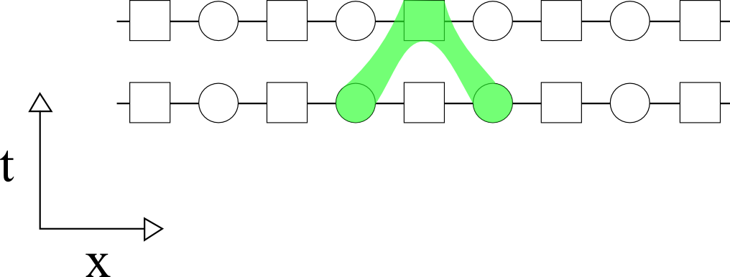
Stencils
Using the staggered grid method, we can effectively sample two adjacent points of our flux quantity
This effectively uses the finite difference from a higher resolution while keeping the lower memory, lower resolution result

Slide 12
Checkerboard Revisited

Slide 13
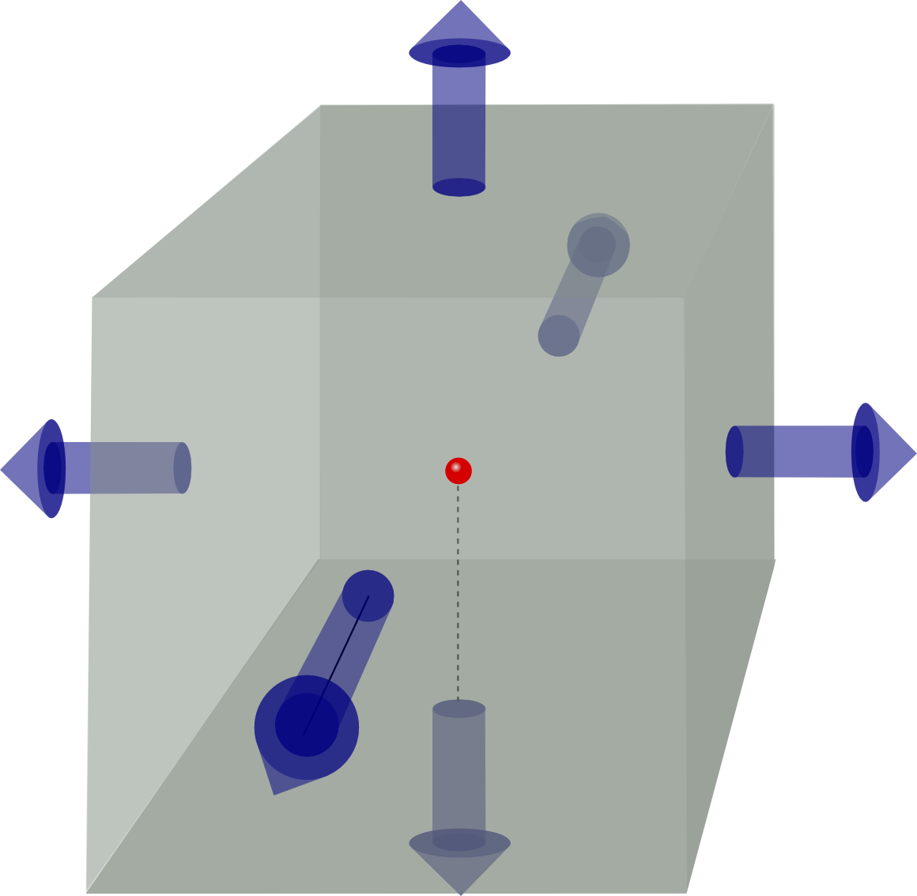
3D Grids
j_{y}
sdfsdf
j_{x}
j_{z}

Slide 14
Example: E&M Waves

Slide 15
Maxwell’s Equations

Slide 16
Maxwell-Faraday System of Equations

Slide 17
Maxwell-Faraday FD Equations

Slide 18
Setting Up Grids

Slide 19
Results

Slide 20
Modern Developments

Slide 21
Summary

